Slide 1
COMPUTATIONAL THINKING: ARTEC ROBO FOR STEM EDUCATION
SESSION 3: DEVELOPMENT OF ROBOTIC SET FOR 21ST CENTURY LEARNING
By DR MARIAM OTHMAN

Slide 2
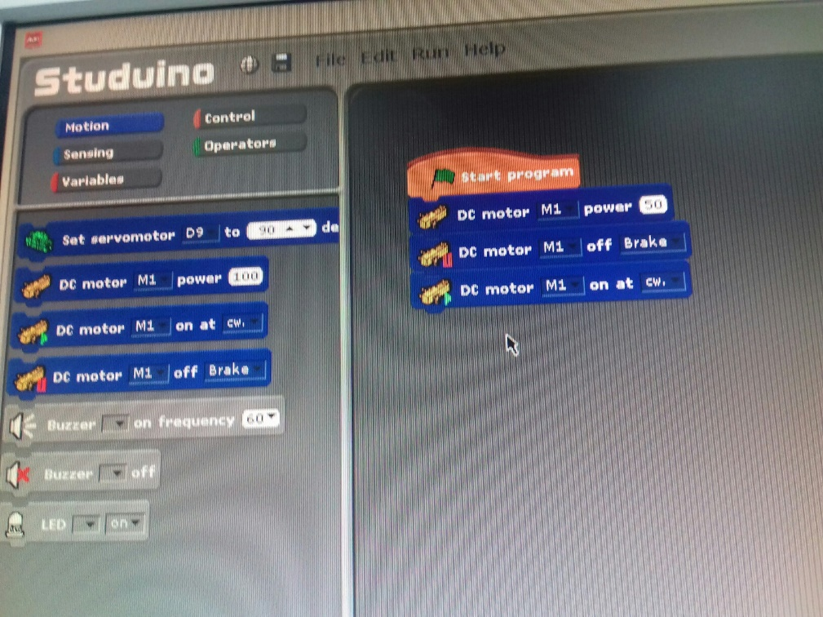
1. TESTING THE DC MOTOR FOLLOW THE STEPS
BE CAUTION OF THE THIN WIRES
IS IT WORKING?
CONNECTING THE WIRES
OPEN THE PROGRAMME
FOLLOW THE STEPS
WHAT HAPPENED?

Slide 4
Notes:
Mungkin x perlu slaid ni ---KIV

Slide 5
VIDEO 00462
AA72501 – opening programme
VIDEO 00462- 3.30-4.35 – setting up
VIDEO 00462 - 10.56-11.20 – testing servo motor
AA72701 – testing servo motor
AA73601 – testing servo motor
AA73701 – testing servo motor

Slide 6
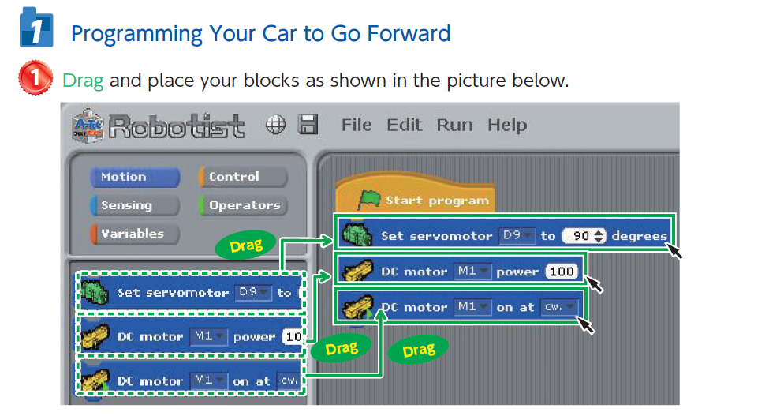
2. MOVE FORWARD

Slide 7
2. MOVE FORWARD

Slide 9
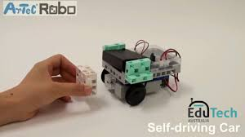
4. BUILD THE CAR
FOLLOW THE MANUAL

Slide 10
VIDEO 00462
16.59 – 17.27 – INSTRUCTION
22.16 – 22.29 – SAMPLE CAR
22.53 – 27.00 – CONSTRUCTING THE CAR
26.54 – 27.30 – MOVE WITHOUT CABLE
28.20 – 29.30 – TRYING TO USE SENSOR (USED IN SLIDE 12)
32.07-32.12 – LIMITED BY CABLE
VIDEO 00463
16.30-17.30 – FACILITATOR EXPLAINED TO MOVE WITHOUT CABLE - RESET, TRANSFER, UNPLUGGED
–

Slide 11
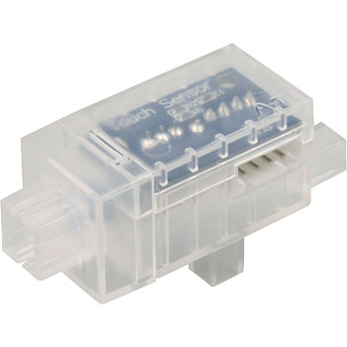
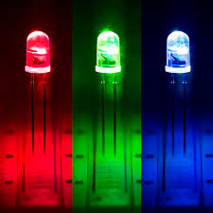
5. EXPLORE ON YOUR OWN
BY ADDING :
i. SENSORS
ii. LED
iii. SOUND

Slide 12
ADDING SENSOR, LED AND SOUND
1. VIDEO 00462
28.20 – 29.30 – TRYING TO USE SENSOR
2. AA00468 – ADDING SENSOR, LED AND SOUND

Slide 13
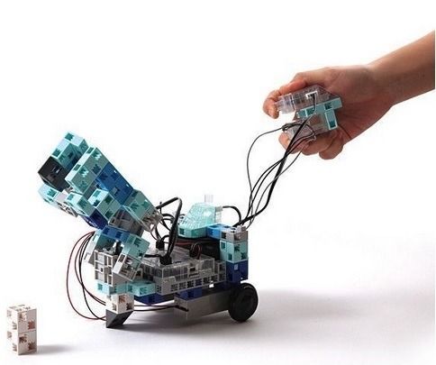
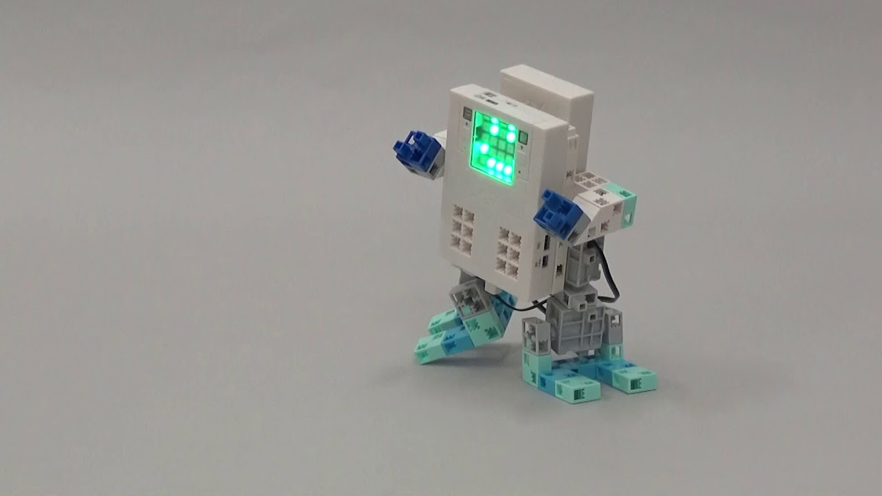
NOW CREATE YOUR OWN PROGRAMME THEN
SHOW TIME
https://www.artec-kk.co.jp/en/artecrobo-movie/?id=20160217_12
https://www.artec-kk.co.jp/en/artecrobo-movie/?id=20160217_7

Slide 14
1. AA074501 - presentation 2. AA074101 - presentation 3.AA074401 - presentation 4. AA074501 - presentation

Slide 15
THANK YOU!

Slide 16
DIY ROBOT
Parts:
vibrating motor (RM4.50)
LEDs (RM10.00 – 125) RM0.10-RM1.00
Battery (RM2.00)
Battery holder (optional – RM2.00)
Paper clips
clothes pins
wires
Tools:
Soldering iron (RM23.50) + solder RM3.00 - 10G)
Glue gun (RM18.50)
~ RM63.50
https://youtu.be/TFkUan5Uujs
SOURCE: http://joshbuild.com/how-to-make-a-mini-robot-bug/

